Slide 1

Uncertainty Modeling in Self-Healing Software Systems
Kim-Pascal Borchart
Machine Learning-based Control of Dynamical Systems
Summer of 2021, Hasso Plattner Institute

Slide 2
Overview and Context
Two Projects
Reinforcement Learning for Self-Repair (Past Seminar)
Uncertainty model, where fixes can fail depending on environment
Machine Learning Control (This Seminar)
Predictive model + python controller to use with mRubis
Plan
Adapt past approach to current architecture
Add it to current project
Evaluate performance

Slide 3
Architecture Differences
 | RL 4 Self-Repair | ML Control
Prediction Goal | Fix order | Fix order
Fix failure | Possible | Never
Fix order based on | max(E[P_{success}] * E_{π}[R]) | max(E_{π}[R])
Issue loading | Batch | „Stream“
Actual Reward | Zero or inferred from table | mRubis / own prediction

Slide 4
Architecture Differences
 | RL 4 Self-Repair | ML Control
Prediction Goal | Fix order | Fix order
Fix failure | Possible
Fix order based on | max(E[P_{success}] * E_{π}[R])
Issue loading |  | „Stream“
Actual Reward |  | mRubis / own prediction

Slide 5
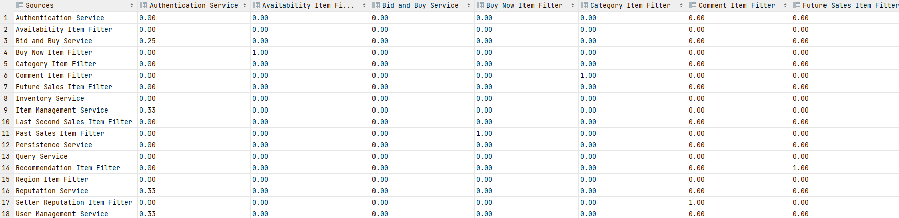
Past-Learned Action Failing Probabilities – Transition Matrix

Slide 6
Past-Learned Action Failing Probabilities – Transition Matrix

Slide 7
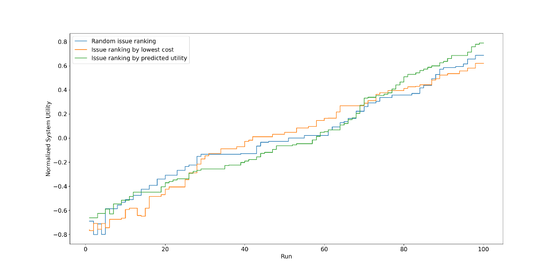
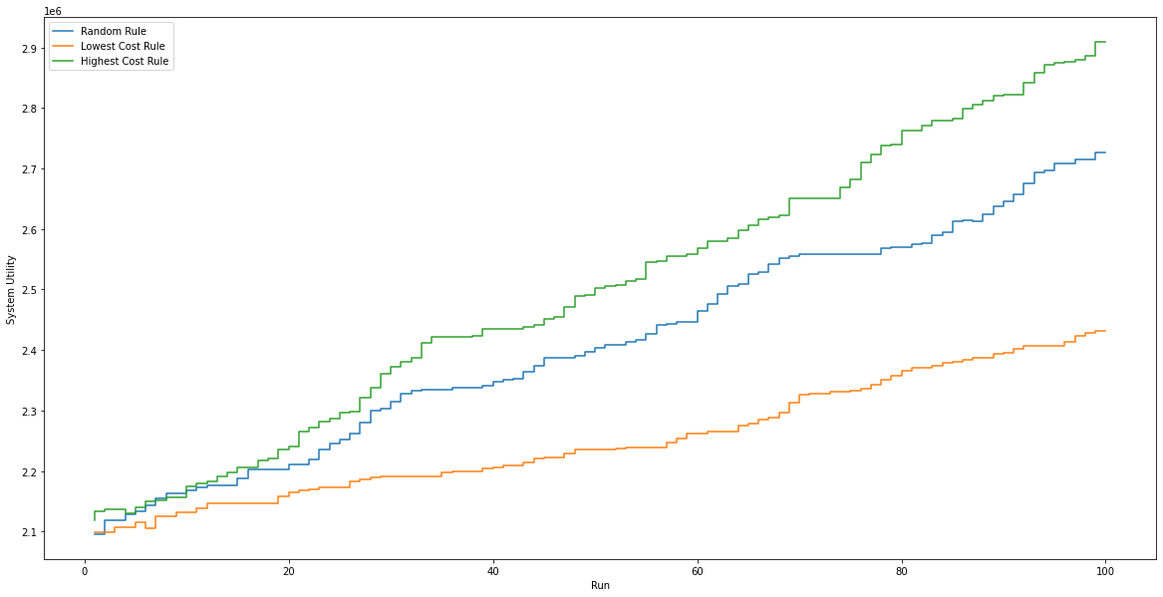
Refresher: Machine Learning Control
Best Rule-Picking Strategy: Highest cost (vs. lowest cost, random)
Best Issue Ranking Strategy: Highest utility (vs. lowest rule cost, random)

Slide 8
Research Questions
RQ1
Are the two architecture approaches compatible?
RQ2
Is the decision-making significantly worse when using uncertainty penalties?
RQ3
How much utility do we lose with the uncertainty penalties?

Slide 9
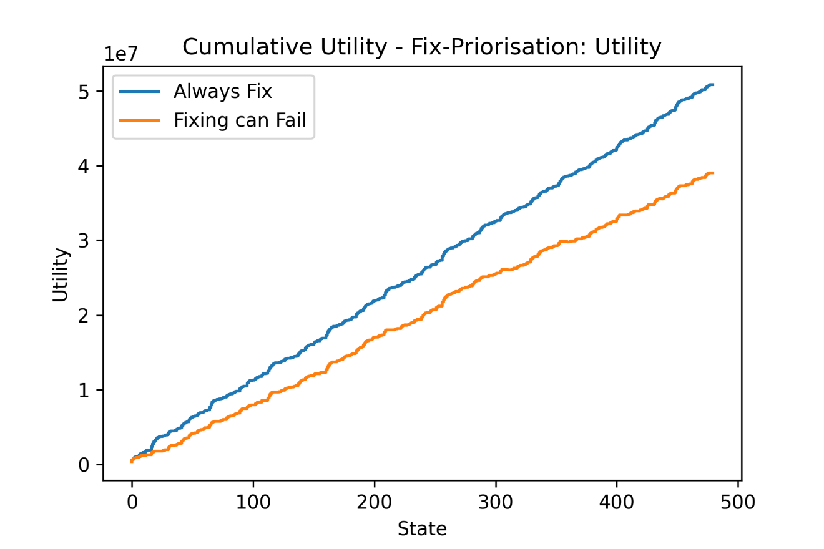
RQ 2 – Significance of Uncertainty Penalties

Slide 10
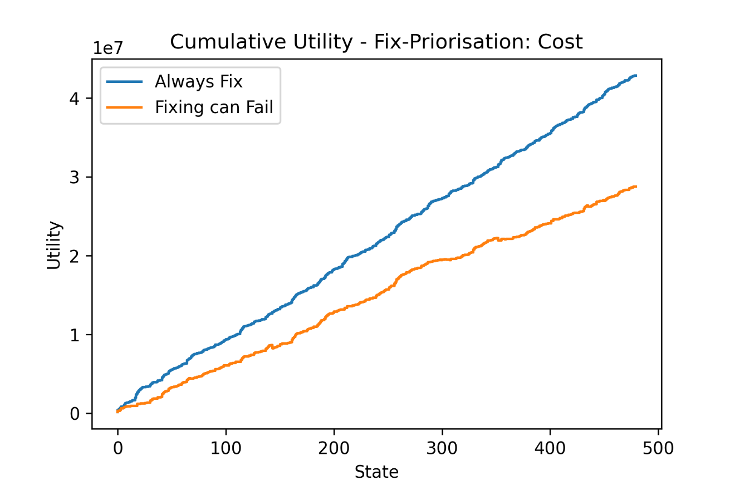
RQ 2 – Significance of Uncertainty Penalties

Slide 11
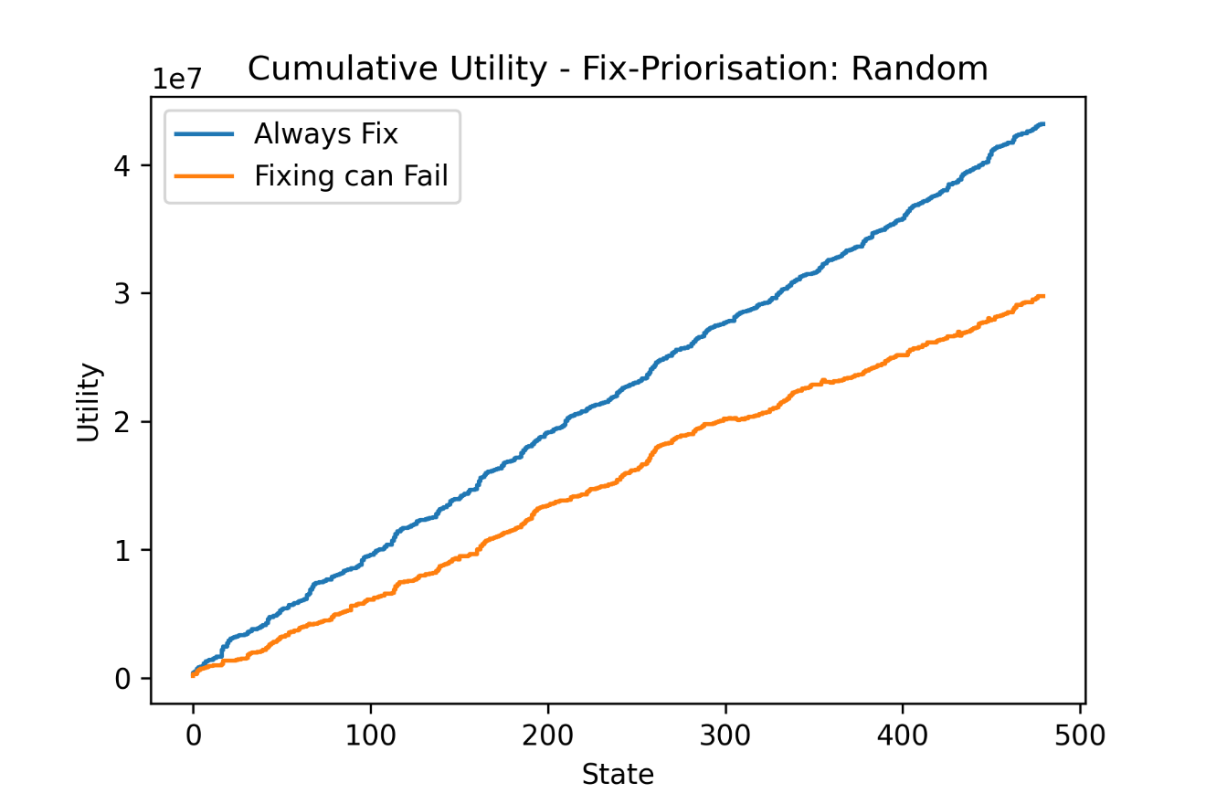
RQ 2 – Significance of Uncertainty Penalties

Slide 12
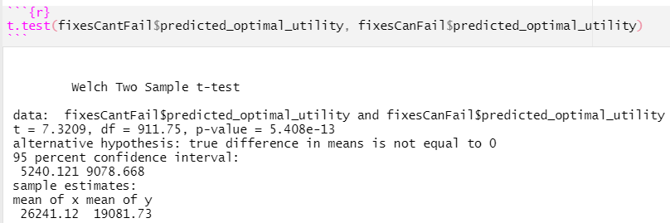
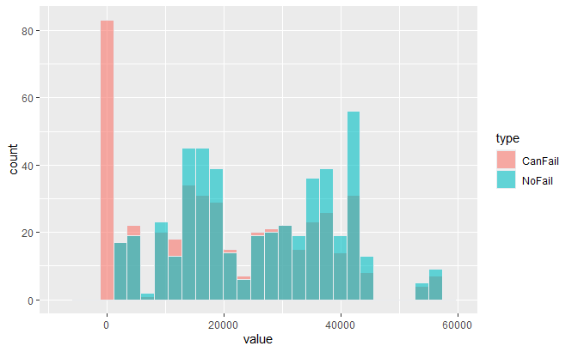
RQ 2 – Statistical Significance of Uncertainty Penalties
H0: The reward penalties have no impact on the actual rewards.
=> t-test
p = 0.00, H0 rejected.

Slide 13
Research Questions
RQ1
Are the two architecture approaches compatible?
RQ2
Is the decision-making significantly worse when using incorrect reward penalties?
RQ3
How much utility do we lose with the uncertainty penalties?

Slide 14

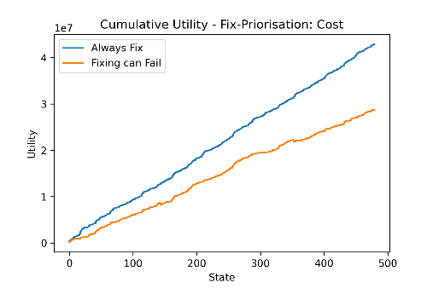
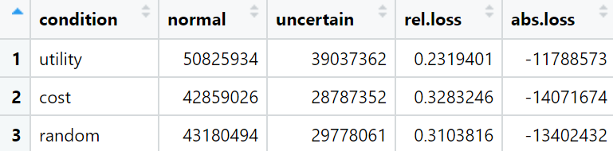

RQ3 – Uncertainty Model Utility Loss

Slide 15
Research Questions
RQ1
Are the two architecture approaches compatible?
RQ2
Is the decision-making significantly worse when using incorrect reward penalties?
RQ3
How much utility do we lose with the uncertainty penalties?
23% - 32%

Slide 16
Discussion and Future Work
Python
Currently a lot of functions with side effects
=> Harder to understand data-transformations
Learn real fix-fail probabilities
Learn longer state horizon
mRubis extensions
Needs „execution plan“ but ignores it ☺
Cumulative utility in mRubis
Fix-fail possibility
Publish-Subscribe architecture to communicate

Slide 17
Disscussion - mRubis and Python Communication
Current
Ideal
python controller
mRubis
python controller
mRubis
get #shops
get all issues
#shops
all issues
#shops times:
get info of shop
Send sorted list of fixes
system utility
info of shop
get #issues
2 messages
#issues
! Requires Message Broker that can handle long messages (RabbitMQ, ...)
#issues times:
request issue
issue
for each issue
send fix for issue
20-40 messages
send actual fix order

Slide 18

Thank you ☺ Questions + Discussion?
Kim-Pascal Borchart
Machine Learning-based Control of Dynamical Systems
Summer of 2021, Hasso Plattner Institute

Slide 19
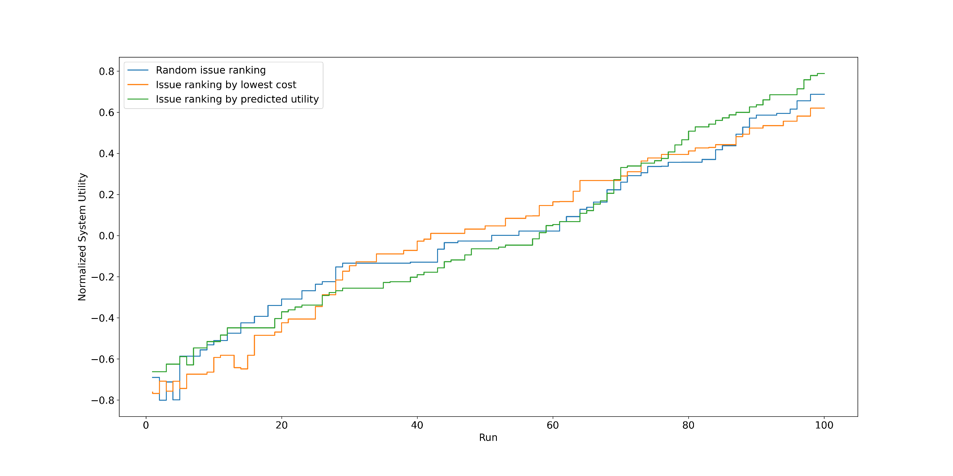
Issue ranking – multiple runs

Slide 20
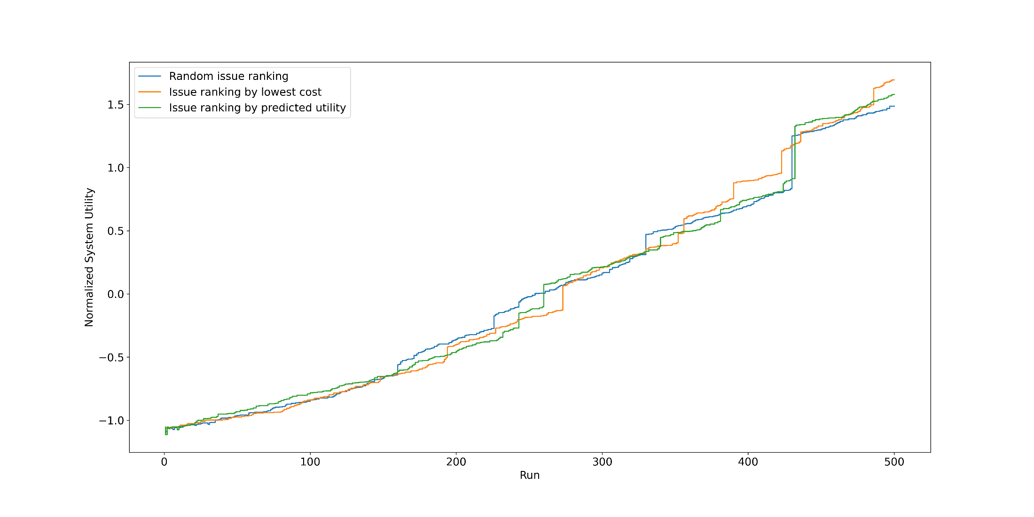
Issue ranking – multiple runs

Slide 21
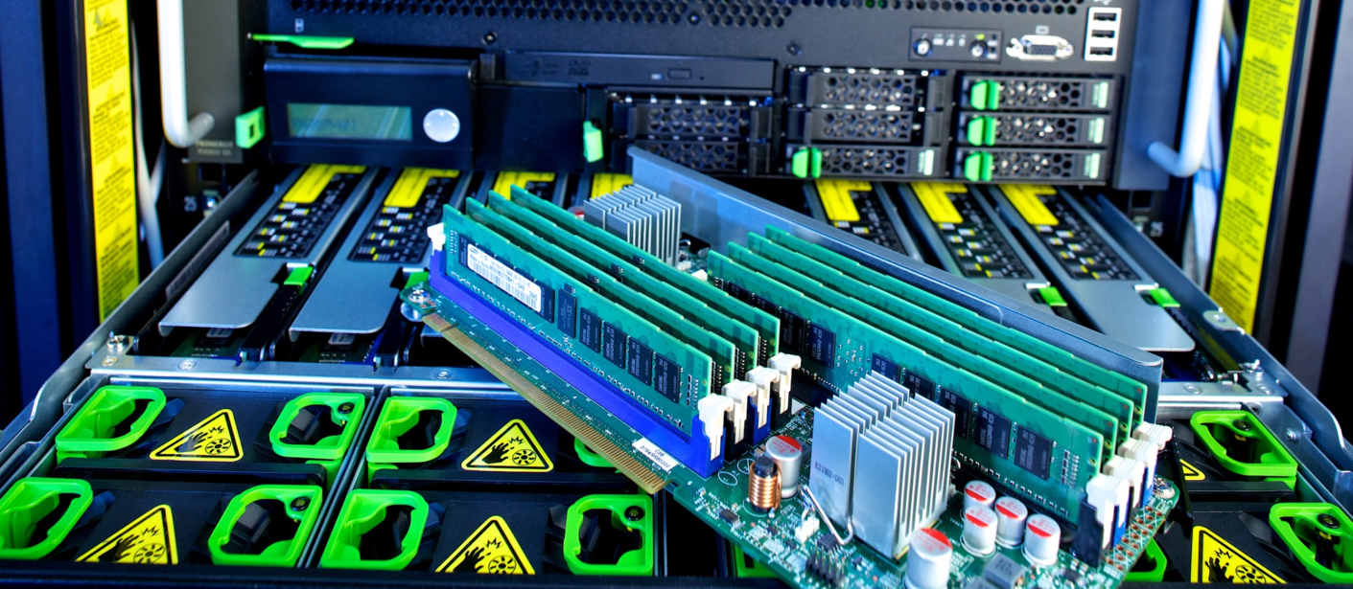

Slide 22


Slide 23


Slide 24
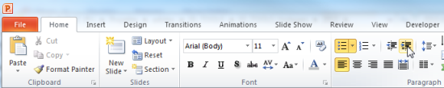
Explanations - Text layers
First text layer for running text.
Second level for bullet points
Third level for bullet points
Fourth level for bullet points
Fifth level for numberings
Sixth level for listings
Seventh text layer for Core Messages
In this template, we pre-formatted different text layers (as you can see on the right side). You don’t have to generate bullet points manually. By the way: Please avoid this!
To change from one text layer to the next, use the Increase / Decrease List Level buttons:

Slide 25
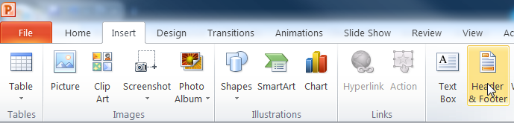
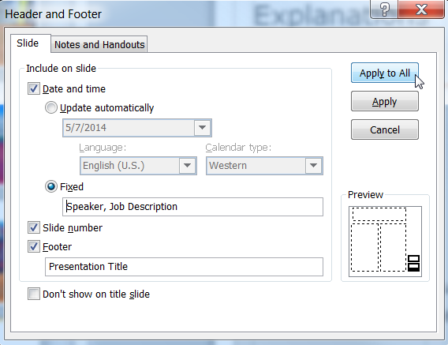
Explanations - Footer
You can insert or change your presentation‘s footer. Click on the Insert-tab | Header and Footer | After filling in your descriptions click on Apply to All.
Descriptions:
Activate date and time and write in:Speaker, Job Description
Activate the slide number.
Activate the footer and write in: Presentation Title
Don‘t use the template without the complete footer.

Slide 26
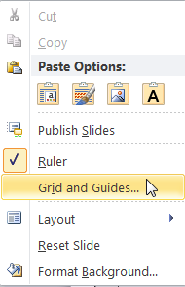
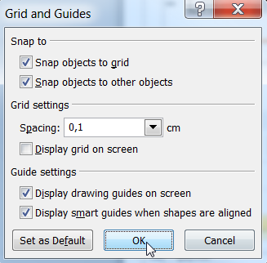
Explanations - Drawing guides
You can enable your guide-lines to align objects on the slide (View | Show | Select the option „Guides“)
Or hit the right mouse button outside the slide and go at „Grid and Guides…“

Slide 27
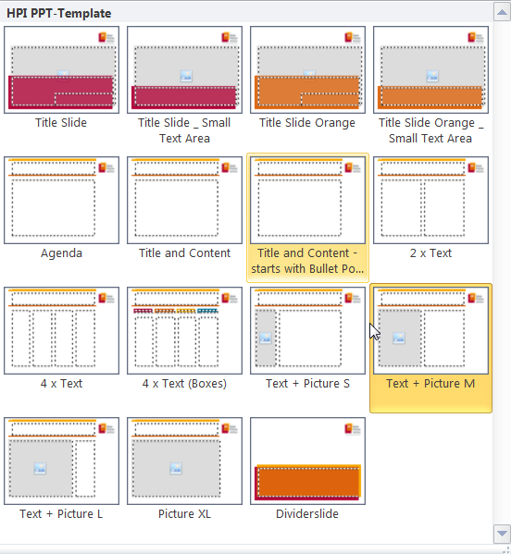
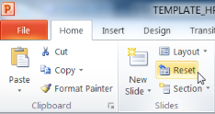
Explanations - Slide layouts
You can choose between different slide layouts. These pre-defined layouts gives you the oportunity to use text and visualisations just the right way.
To use these layouts:
Click on the Home-tab | New Slide or Layout | and choose one out of the layouts
Click „Reset“ to reset to the predefined slide layout.

